Slide 1
Valuing S&P 500
Approach & Methodology Paper
Prepared by: Devesh Vyas
Under guidance of: Mr. Parth verma

Slide 2
Contents
1. | Context
2. | Approach & Methodology
3. | Valuation
4. | Sources & Disclaimer

Slide 3
Contents
1. | Context
2. | Approach & Methodology
3. | Valuation
4. | Sources & Disclaimer

Slide 4
Context
1.1 Introduction
The S&P 500 is currently trading at 5634.61. The index have been on a rollercoaster ride, after hitting the month lows, it soared to previous month’s high levels. The catalyst in the precedented growth has been the optimism from the investors in response to the FEDs rate cut to cool sky rocketing inflation down. The quarterly earnings reports have been a mixed bag reaction for investors. While 78% of the S&P 500 companies have reported positive earnings surprises, the magnitude of these surprises is below the historical averages. 9 of the 11 sectors have reported Y-O-Y growth, with IT, Financials & Healthcare leading the way. However, the revenue surprises are minimal, indicating a cautious outlook.
This calls for revisiting the valuation of the S&P 500. This whitepaper is a sheer academic project & it discusses the approach & methodology of valuing the index by considering the dividends, buybacks, earnings growth (EPS) of S&P 500 sectors, Equity Risk Premium (ERP), & the 10Y Government (Treasury) bond as risk-free rates. The valuation in this deck is based on the methodology used by Prof. Ashwat Damodaran (Dean of Valuation- NYU) & his teachings on the Discounted Cash Flow (DCF) method.
Alike other valuations, this paper also used assumptions & understandings, which makes it subjective in nature for interpretation & should be used to gauge broader ideas on the under/overvaluation of the index & should not be used as an investment/disinvestment rationale as it is made purely for academic purpose.

Slide 5
Approach & Methodology
1. | Context
2. | Approach & Methodology
3. | Valuation
4. | Sources & Disclaimer

Slide 6
Approach & Methodology
Compounded Years | Dividend Yields | Buyback Yields | Total Yields
20 Years | 1.90% | 2.32% | 4.21%
15 Years | 1.82% | 2.22% | 4.04%
10 Years | 1.73% | 2.11% | 3.84%
5 Years | 1.47% | 1.77% | 3.24%
3 Years | 1.50% | 1.83% | 3.33%
2.1 Expected Dividends & Buybacks
In DCF, valuation is done by discounted Free Cash Flows to Equity (FCFE) at an appropriate discount rate. However, it is a very tedious task to calculate the FCFE of each of the 500 companies in the S&P 500. However, the estimation of the expected dividends & buybacks based on the historical data is synonymous with FCFE.
While the dividend yields are readily available on the S&P Global, buyback data was difficult to collect. Therefore, the data was taken from the site of Ashwat Damodaran (NYU Stern). After collecting & analyzing the data it could be concluded that buybacks in the US are more than the dividends due to the maturity of the market, there is little scope for a high-growth phase from here on for the US markets.

Slide 7
Approach & Methodology
Compounded Years | Earnings Growth (%)
20 Years | 6.20%
10 Years | 6.33%
7 years | 6.52%
5 Years | 6.77%
3 Years | 7.99%
2.2 Expected Growth in S&P 500 Earnings
Earnings of the S&P 500 are derived by dividing the Price-to-Earnings ratio (PE Ratio) of the index by its absolute level.
PE Ratio & Index levels are obtained from Macrotrends.com & Investing.com respectively, & with minimal analysis earnings growth & its growth can be obtained.
There could be an argument over which growth rate should be considered for valuation. Since there is not much difference between 3 Years & 20 Years average compounded annual growth % (+/- 1.5%), considering the valuation to remain forward-looking & based on the current financial scenario, earnings growth compounded for 3 years is used for valuation in this paper.

Slide 8
Approach & Methodology
2.3 Risk-Free Rate (Rfr)- 10Y US Treasury Bond Yield
The risk-free rate is the basic driver for DCF Valuation & is a metric of opportunity cost. It is convenient to use 10 Years of Government Bond Yield as the risk-free rate. However, it can be further adjusted for default risk & country risk. But, since the default spread of the USA is known as transaction cost & as per Moody’s ratings there is no default risk/country risk we can safely consider US 10Y Govt. Bond as our Rfr.
There could be an argument on which rate should be considered for valuation. In the early 2000s, the T-Bonds traded around 6%-7% which was the highest in the past 24 years. But since the valuation is forward-looking, the latest Risk-Free rate has been taken into calculation.
Compounded Years | 10Y US Treasury Bond Yields
20 Years | 2.88%
15 Years | 2.48%
10 Years | 2.47%
5 Years | 2.69%
Latest | 4.23%

Slide 9
Approach & Methodology
2.4 Implied Market Risk Premium (MRP/ERP)
The market risk premium is the additional measure that expects returns on an index or portfolio of investments above the given risk-free rate. The implied Equity Risk Premium (ERP) is equal to the slope of the security market line (SML).
It is an incentive for assuming risk beyond the government bonds over equity markets in general.
A higher ERP indicates a cautious market where the investors are defensive while investing in the equities & represents their willingness to pay a lower price for the same cash flows & earnings
Implied ERP is reverse calculated by considering the current index value and expected FCFEs.
Compounded Years | Implied ERP
20 Years | 4.24%
15 Years | 4.39%
5 Years | 3.50%
3 Years | 2.98%
Latest | 2.47%

Slide 10
Valuation
1. | Context
2. | Approach & Methodology
3. | Valuation
4. | Sources & Disclaimer

Slide 11
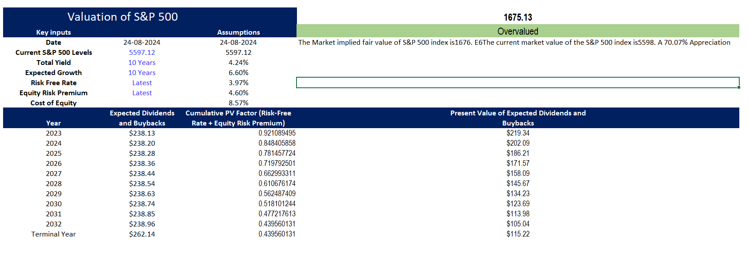
Valuation

Slide 12
Sources & Disclaimer
1. | Context
2. | Approach & Methodology
3. | Valuation
4. | Sources & Disclaimer

Slide 13
Sources & Disclaimer
4.1 References & Sources
https://www.investing.com/
http://www.market-risk-premia.com/market-risk-premia.html
https://pages.stern.nyu.edu/~adamodar/New_Home_Page/home.htm
4.2 Disclaimer
This information is for educational purposes only and is not an investment/disinvestment recommendation not to be representative of professional expertise, but to be used as a forum for opening the discussions around trading. All examples and analyses used herein are for illustration purposes only, and of personal opinions of the author. All examples and analyses are intended for these purposes and should not be considered as a piece of specific investment advice. The risk of loss in trading can be substantial. Users of this paper must consider all the relevant risk factors including their financial situation before trading. You understand & acknowledge that there is a very high degree of risk involved in trading securities. The author assumes no responsibility or liability for your trading & investment results. Further, it should not be assumed that the methods/techniques/indicators presented in this deck will be profitable or that they will not result in losses.

Slide 14
Open to listening to any feedback or suggestions to further improve the findings or the approach followed in the report
Thank You!

